Slide 1
Cascading Style Sheets Presentation 4

Slide 2
Normal flow
Normal Flow, or Flow Layout, is the way that Block and Inline elements are displayed on a page before any changes are made to their layout. The flow is essentially a set of things that are all working together and know about each other in your layout. Once something is taken out of flow it works independently.

Slide 3
Normal flow
In normal flow, inline elements display in the inline direction, that is in the direction words are displayed in a sentence according to the writing mode of the document.
Block elements display one after the other, as paragraphs do in the writing Mode of that document. In English therefore, inline elements display one after the other, starting on the left, and block elements start at the top and move down the page.

Slide 4

Beyond Normal Flow
CSS allows for boxes to be positioned outside the normal flow:
Relative positioning
span’s shifted backwards relative to normal flow

Slide 5
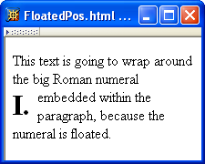
Beyond Normal Flow
CSS allows for boxes to be positioned outside the normal flow:
Float positioning
span taken out of normal
flow and “floated” to the
left of its line box

Slide 6
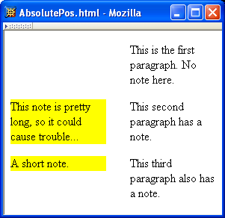
Beyond Normal Flow
CSS allows for boxes to be positioned outside the normal flow:
Absolute positioning
span’s removed from
normal flow and
positioned relative
to another box

Slide 7
Beyond Normal Flow
Properties used to specify positioning:
position: static (initial value), relative, or absolute
Element is positioned if this property not static
Properties left, right, top, bottom apply to positioned elements
Primary values are auto (initial value) or CSS length
float: none, left, or right
Applies to elements with static and relative positioning only

Slide 8
Beyond Normal Flow
Relative positioning
Specifying positive value for right property of relatively positioned box moves it to left
<span style="background-color:red">&nbsp;&nbsp;&nbsp;&nbsp;
</span><span class="right">Red</span>
span
containing
text moves
left

Slide 9
Beyond Normal Flow
Relative positioning
Specifying negative value for left property also moves box to left
<span style="background-color:red">&nbsp;&nbsp;&nbsp;&nbsp;
</span><span class="right">Red</span>
same
effect as
before

Slide 10
Beyond Normal Flow
Float positioning
Specify value for float property

Slide 11
Beyond Normal Flow
Float positioning
Specify value for float property
Floated element becomes a CSS block
element (e.g., can set height and width)

Slide 12
Beyond Normal Flow
Absolute positioning
Specify location for corner of box relative to positioned containing block
p elements are positioned (but don’t move!)
margin area
padding area
containing
block
This second paragraph has a
note.

Slide 13
Beyond Normal Flow
Absolute positioning
Specify location for edges of box relative to positioned containing block

Slide 14

Beyond Normal Flow
Absolute positioning
10em
padding top
edge
padding left
edge

Slide 15
Beyond Normal Flow
Absolute positioning
8em

Slide 16
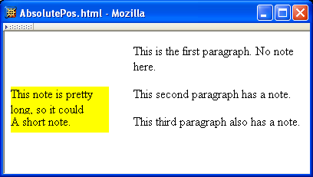
Beyond Normal Flow
Absolutely positioned box does not affect positioning of other boxes!
Second absolutely
positioned box
obscures first

Slide 17
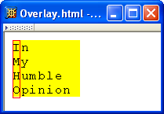
CSS Position-Related Properties
z-index: drawing order for overlaid boxes (largest number drawn last)

Slide 18
CSS Position-Related Properties
display: value none means that element and its descendants are not rendered and do not affect normal flow
visibility: value hidden (initial value is visible) means that element and its descendants are not rendered but still do affect normal flow

